Slide 1
Muon Response Analysis An analysis of Muon count, Weather Conditions and their correlations
By andira putri and lucius anderson

Slide 2
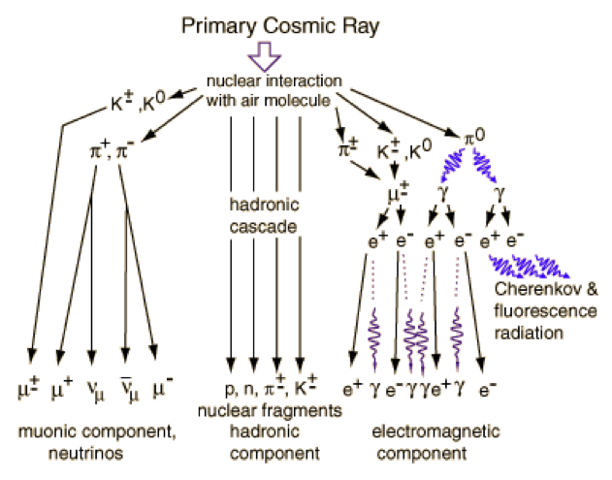
What is a muon?
A muon is a type of subatomic particle.
The name is pronounced “myoo-on,” and comes from the Greek letter µ, which we spell “mu” and pronounce “myoo.”
A muon is a type of particle very much like an electron. In fact, it is exactly the same as an electron – except heavier. The mass of a muon is 207 times the mass of an electron.
Muons are the product of the collision between cosmic rays and atmospheric nuclei
Muons are radioactive and they decay with a half-life of 1.52 microseconds.

Slide 3

Purpose
Dr.Xe-- a physicist here at GSU, gave a presentation during the beginning of the semester covering his research of the Muon, exactly what it is, and his current findings
After Dr.Xe’s presentation, our group decided that it would be very interesting to analyze muon count and see if local weather factors/conditions affected the muon count

Slide 4
Preliminary Research
To begin our studies, Andira and I first had to research the Muon Particle and develop a more key understanding.
Andira and I made visits with Dr.Xe to gather more information
We visited the physics department and received a tour and Dr.Xe and his graduate students showed us the location of where they take muon count
Dr.Xe’s team uses four distinct devices for monitoring cosmic ray activity:
Pot Detector
Four Paddle Detector
Double Paddle Detector
Weather Station Device

Slide 5
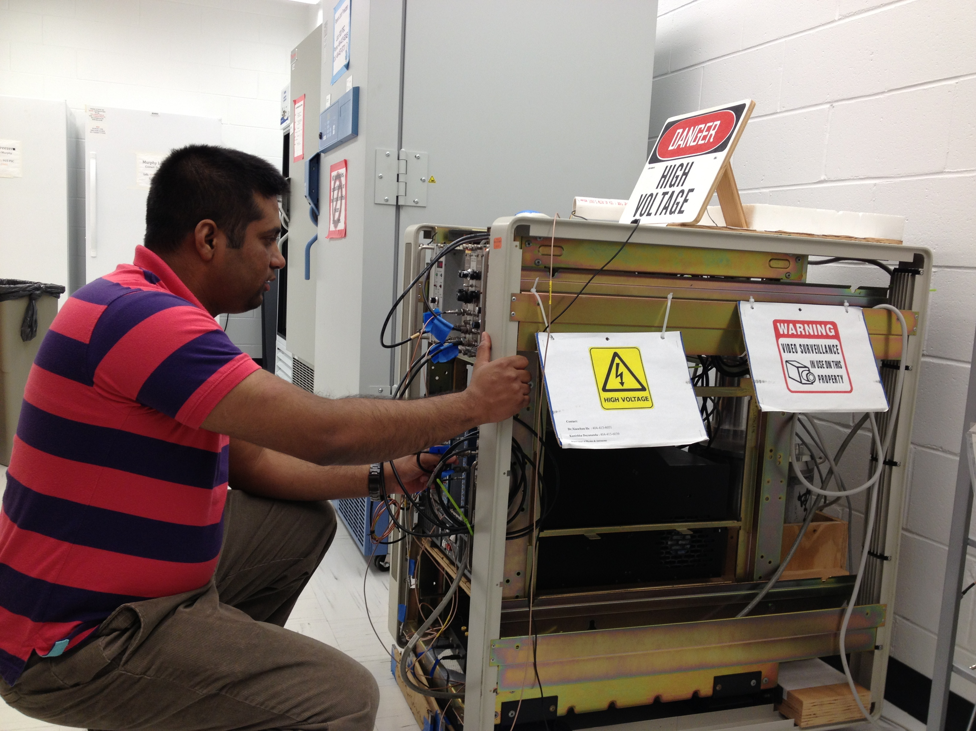
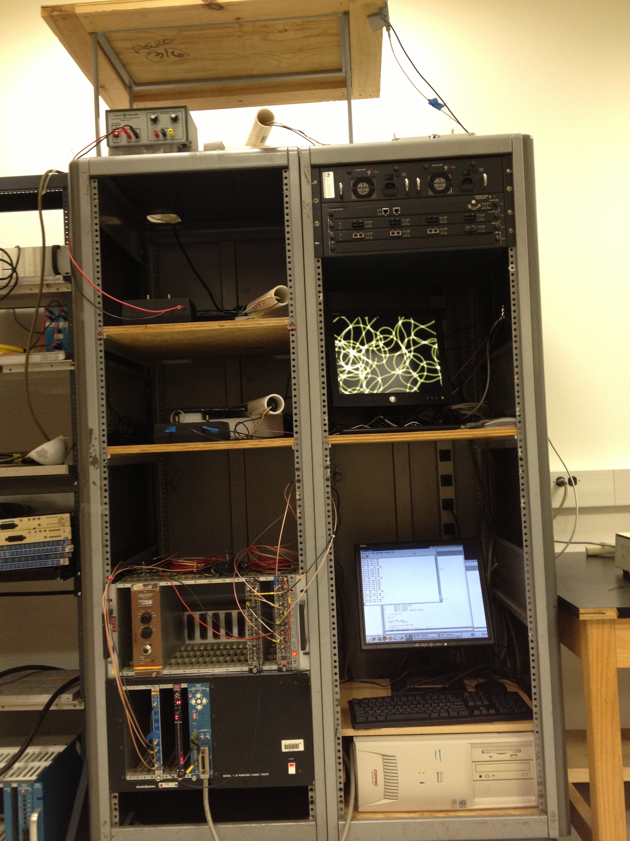
Images Of Devices
Pot Detector
Four-Paddle Detector
Pot detector is basically a cooking pot filled with liquid scintillator, which is why it is called "pot". The DAQ system is built with CAMAC and NIM modules.
Four-Paddle detector has four plastic scintillator plates. PMTs are connected with scintillators and protected by PVC pipe.

Slide 6
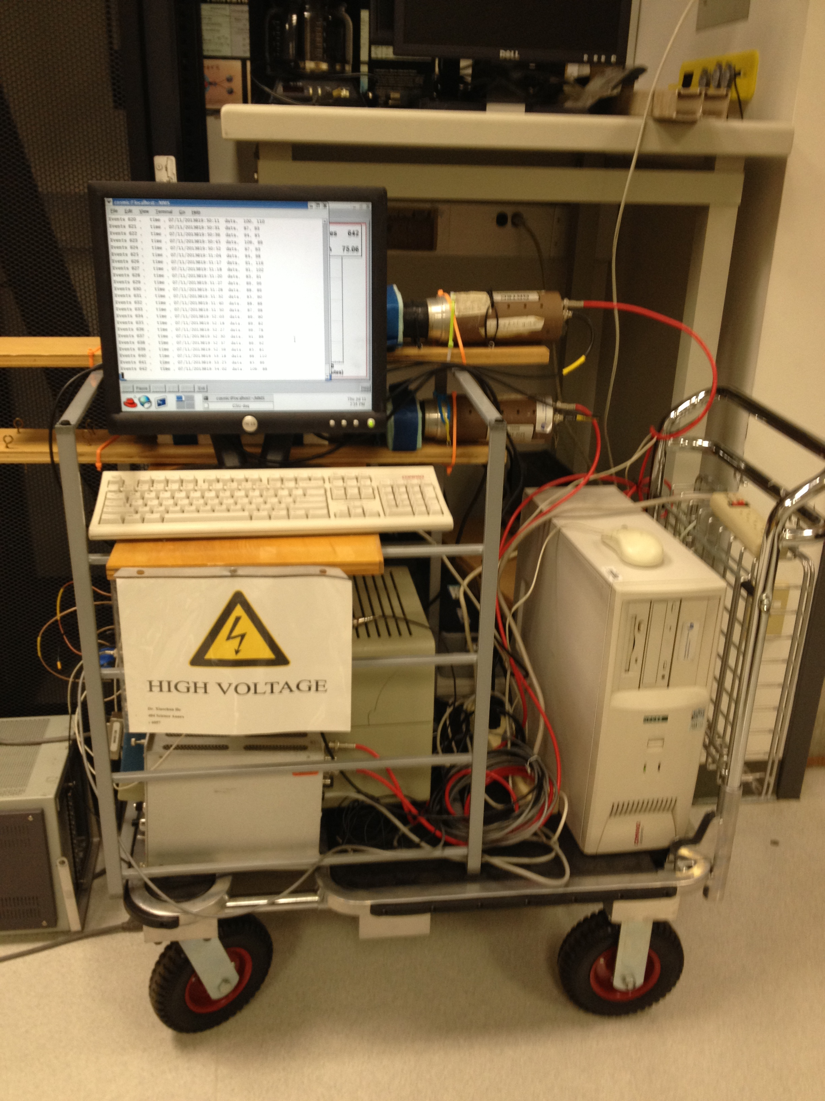
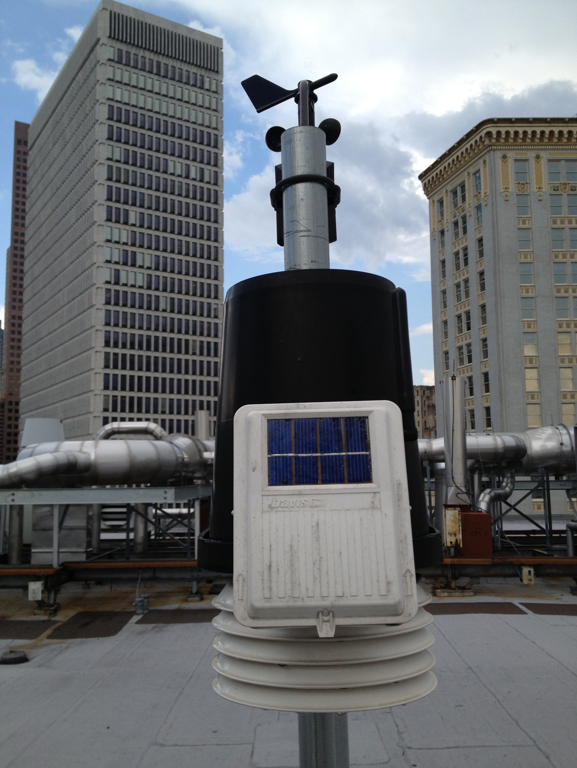
Images of Devices
Double-Paddle Detector
Weather Station
Double-Paddle detector has two plastic scintillator plates.
Weather station is installed on the roof of Natural Science Center, Georgia State University.

Slide 7

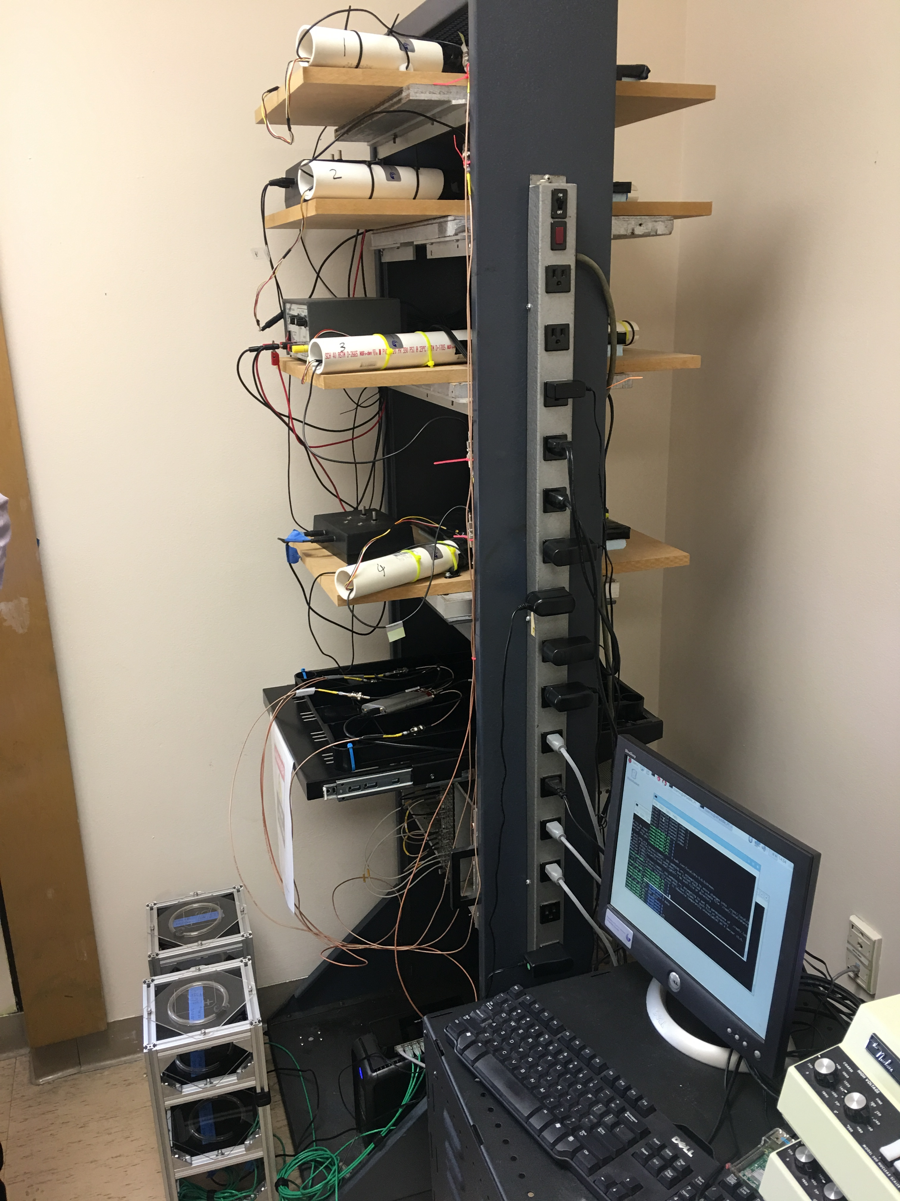
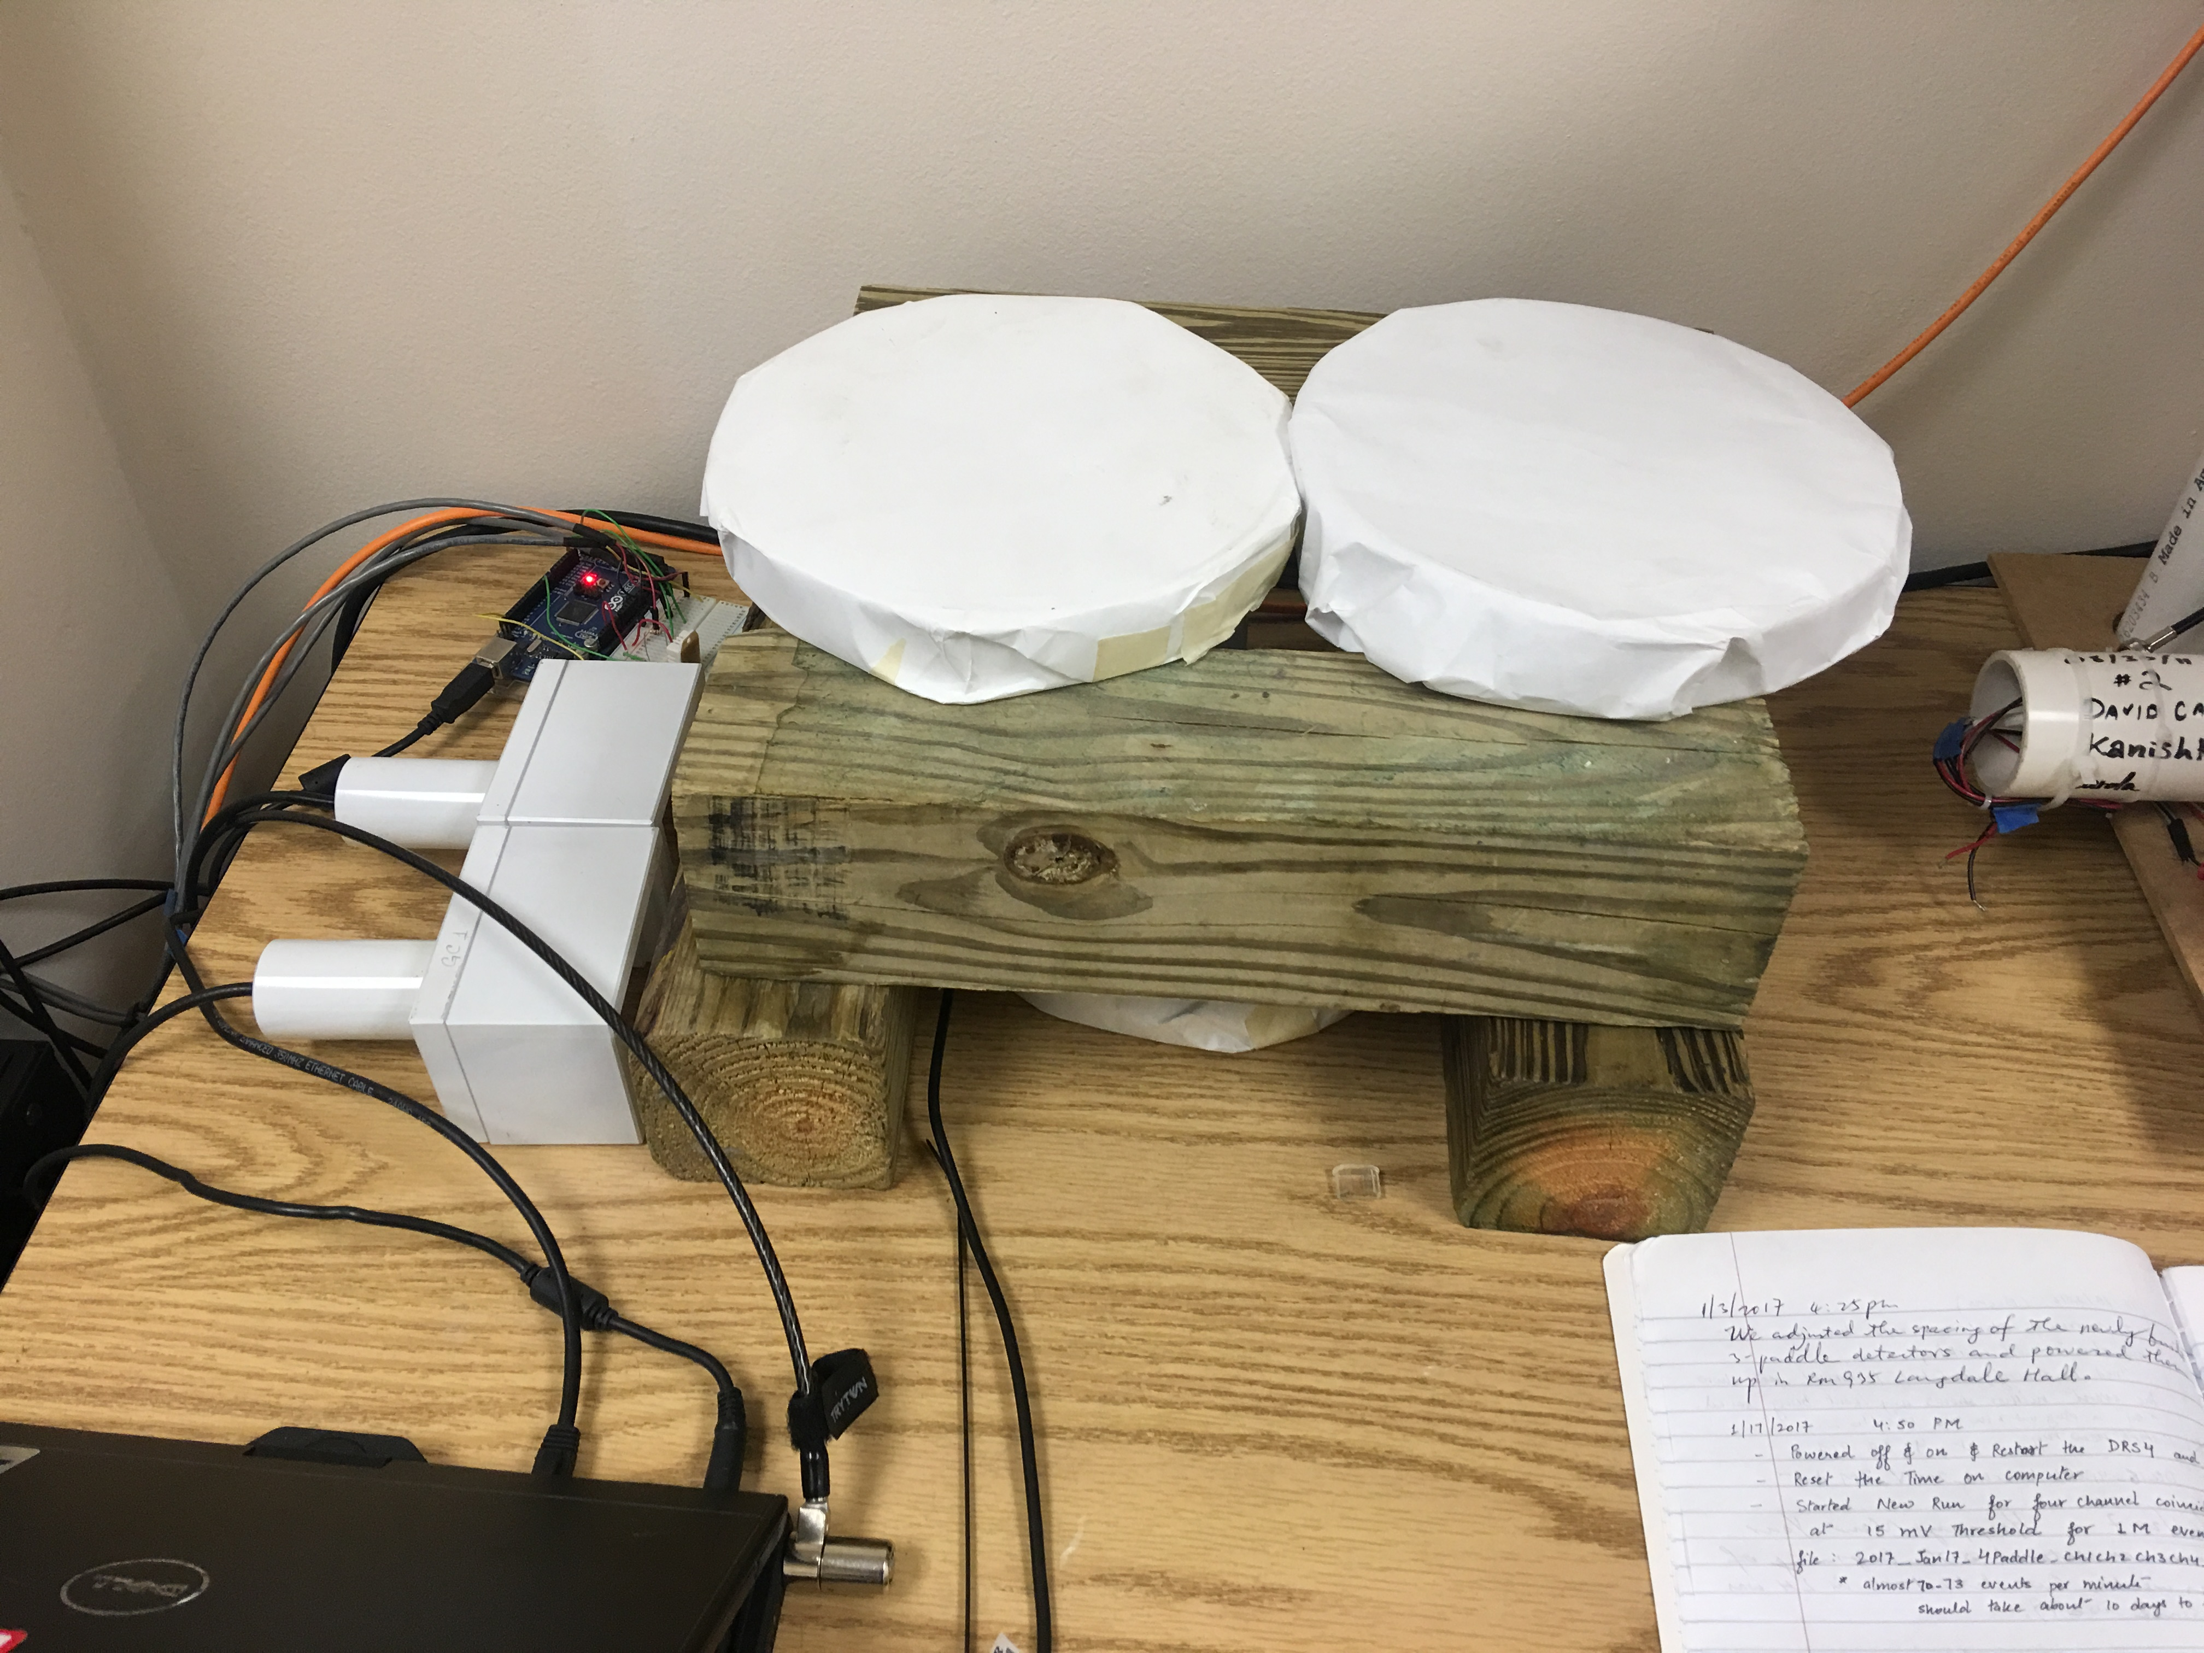
Images Captured from My Cellular Device

Slide 8
Data Accumulation and Factors to be Analyzed
After preliminary research in our project, the time came to accumulate data and analyze certain factors
Data sets were accumulated from:
Dr.Xe and his research team directly
Dr. Xe gathers findings from his devices at various altitudes
One device atop the roof, the other in the physics lab(for elevation variances)
MesoWest an ongoing cooperative project, started in 1996, to provide access to current and archive weather observations across the United States.
Taken from station KATL a weather station located near Hartsfield Jackson International airport, between 9-10 miles away from the school

Slide 9
Data Accumulation and Factors to be Analyzed
After collection of the data sets we had narrowed our analysis down to six factors:
Temperature
Pressure
Wind Speed
Relative Humidity
Cloud Layer 1
DewPoint

Slide 10
Data Accumulation and Factors to be Analyzed
Data is then averaged by over the number of days accumulated at the time.
During the time Dr.Xe’s research had data from January 01,2017 to March 17,2017
A total of 69 days
Each factor was then averaged by day in Microsoft excel using tables and by table and then directly imported into Matlab for processing

Slide 11
Data Accumulation and Factors to be Analyzed
file:///Users/luciusanderson/Desktop/ALL%20DAILY%20AVERAGES%20for%20powerpoint.htm

Slide 12
Data Plotting
After averaging the data and finding factors we thought were good factors, we used Matlab to plot and show the factors
Plots include over time plots
Vs plots to show intuitive thinking and factor correlation

Slide 13
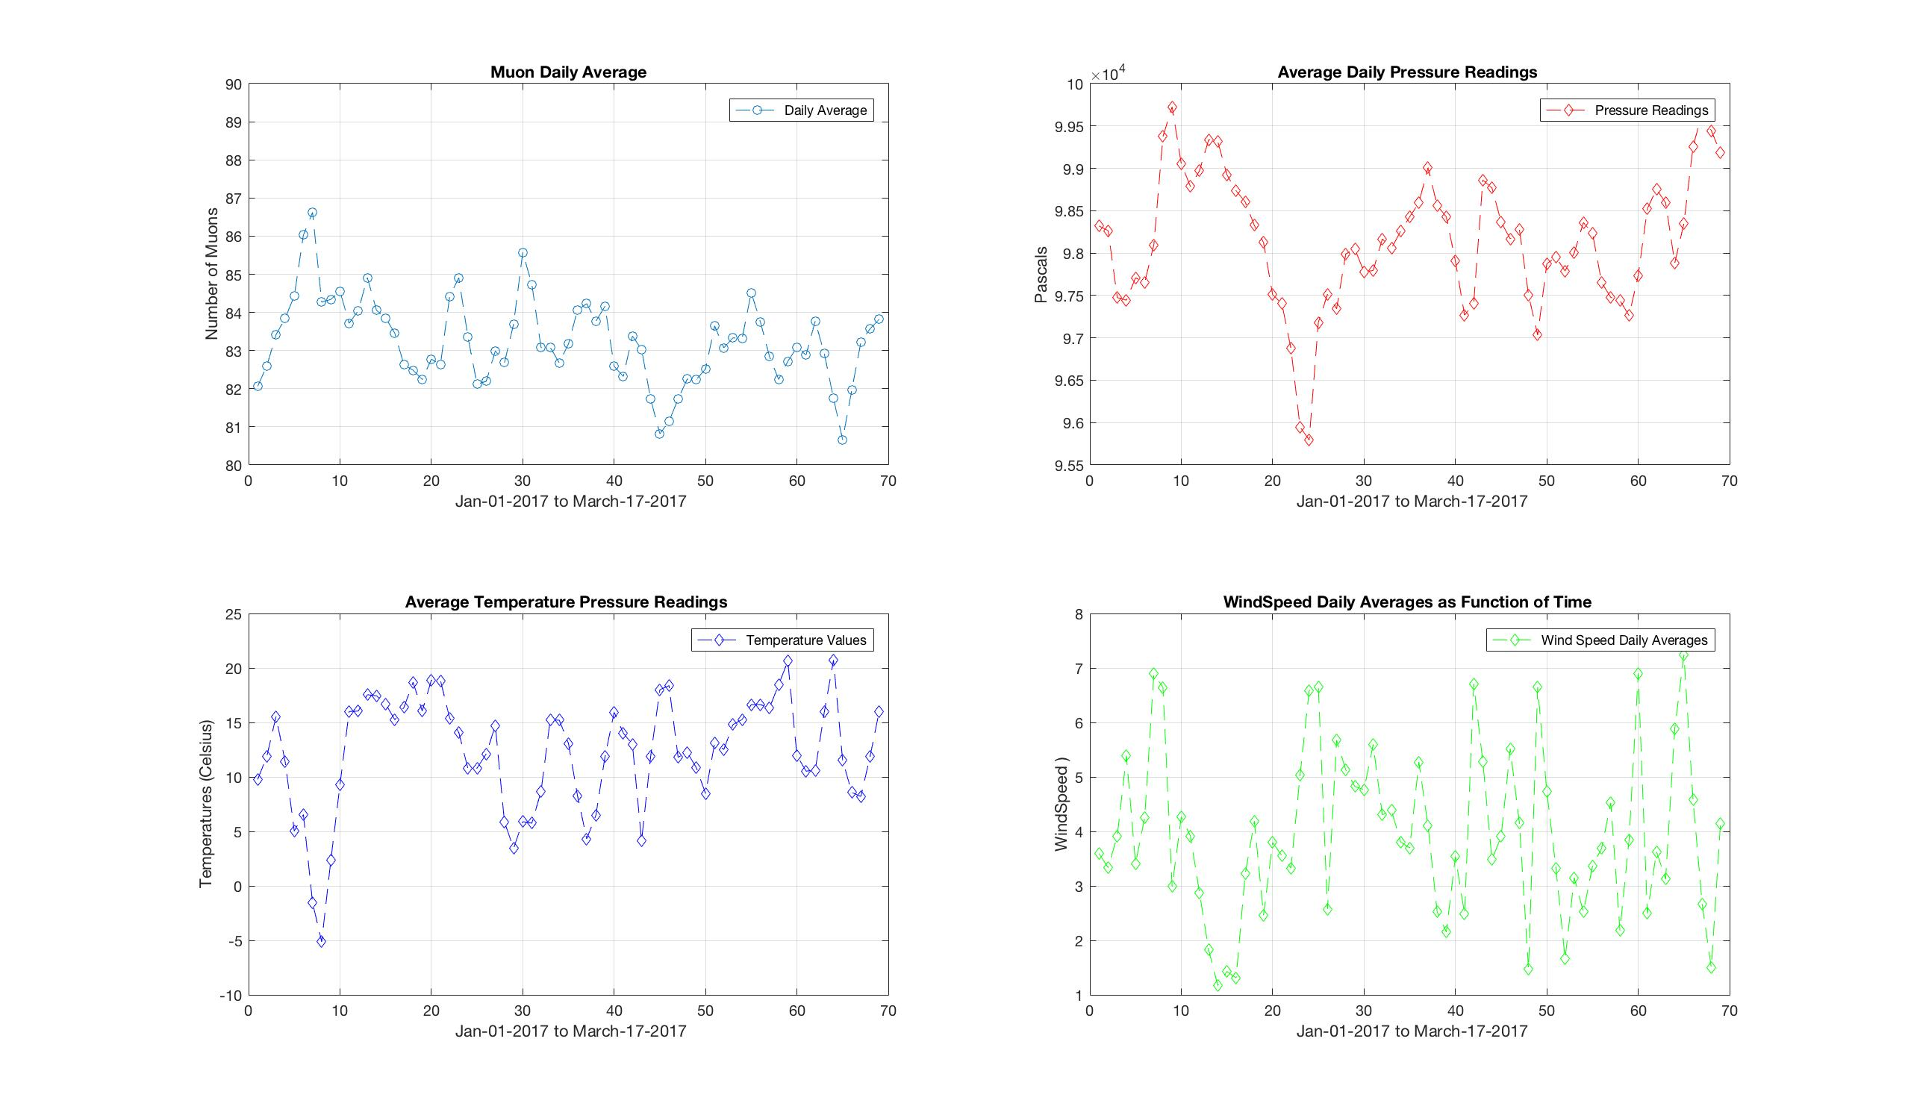
Data Plotting: Over time plots

Slide 14
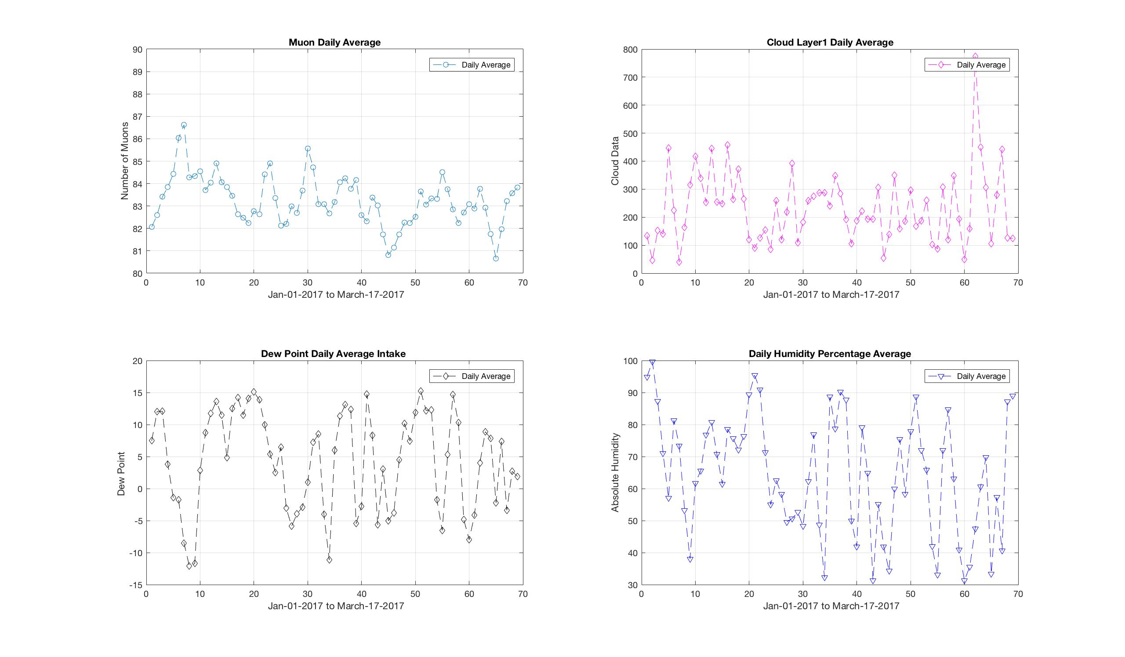
Data Plotting: Over time plots

Slide 15
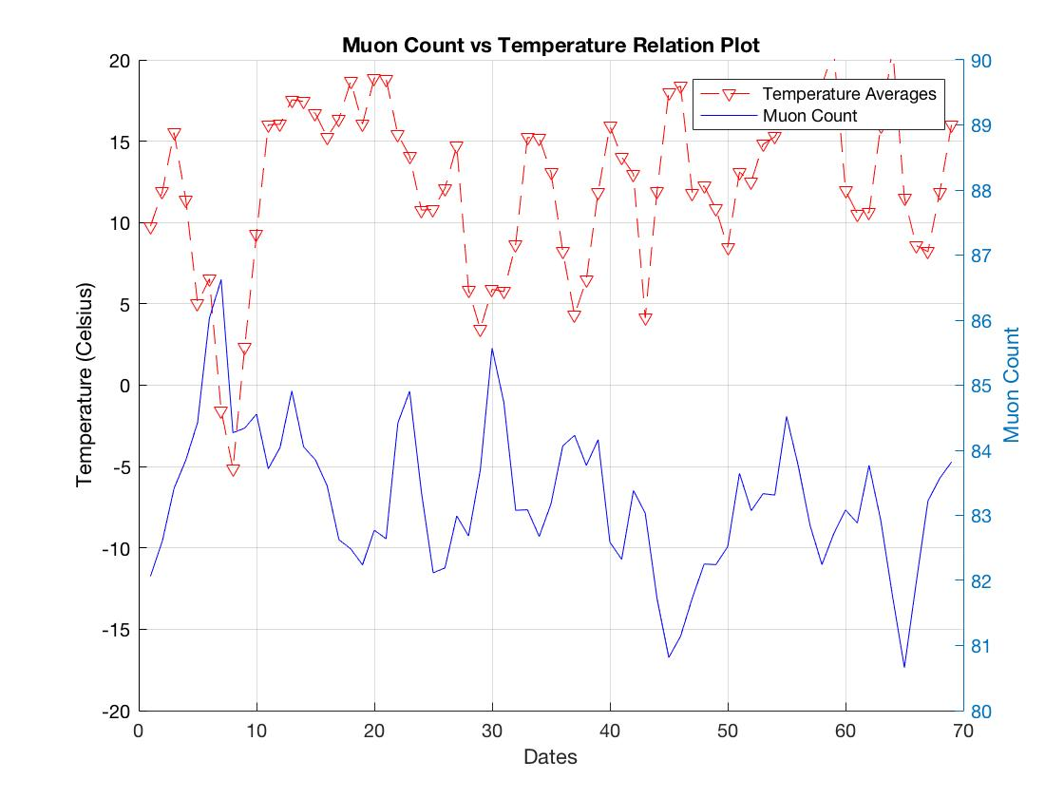
Muon Count vs Temperature Plot

Slide 16
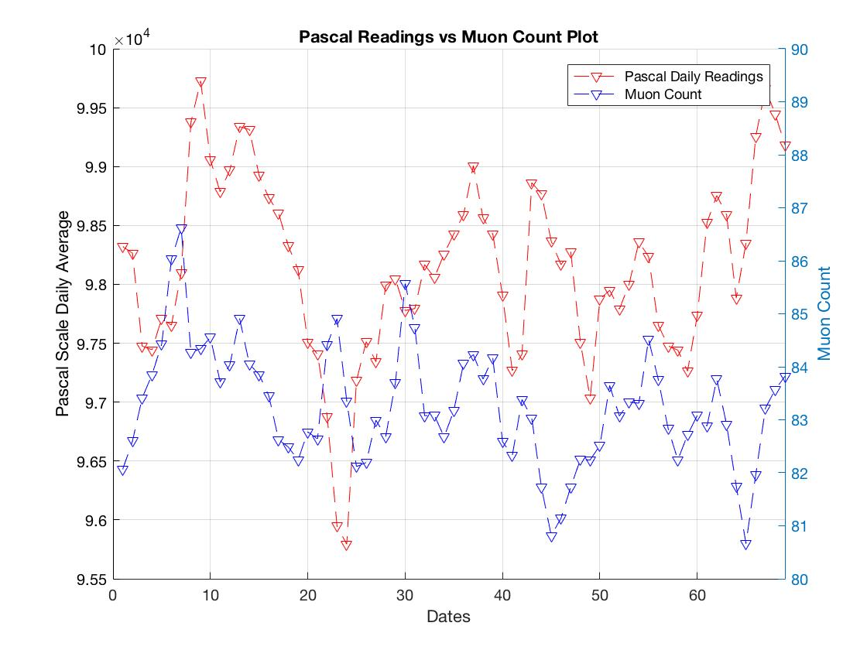
Muon Count vs Pressure Plot

Slide 17
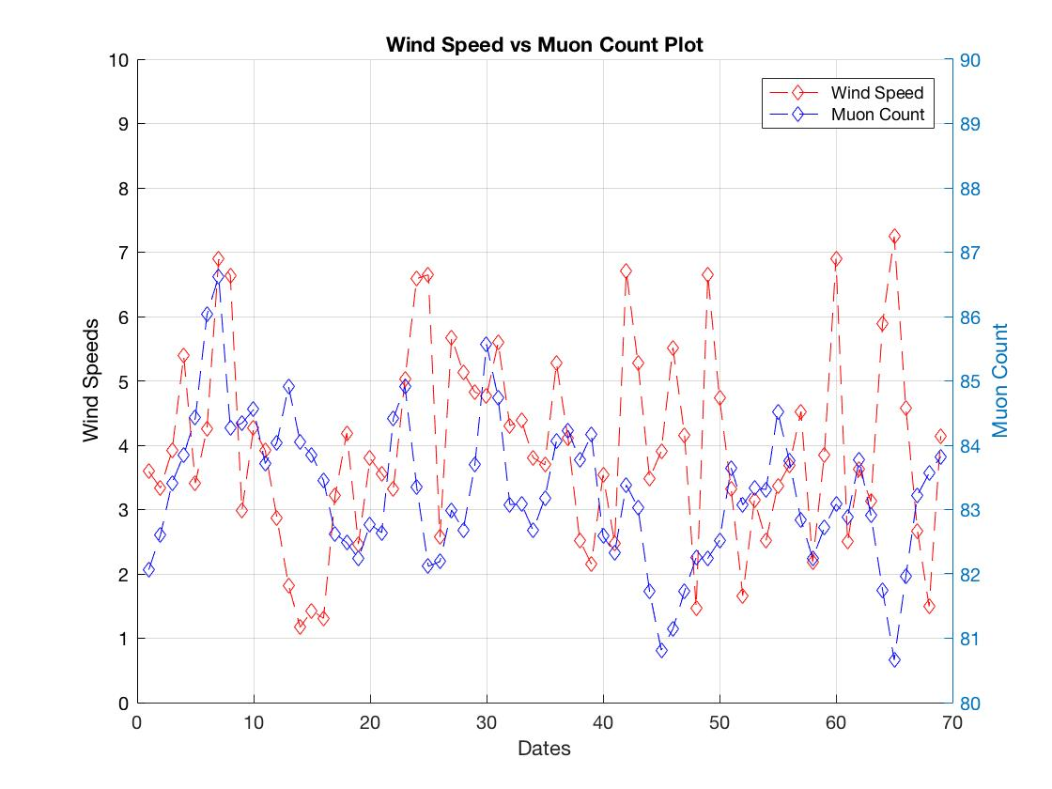
Muon Count vs Wind Speed Plot

Slide 18
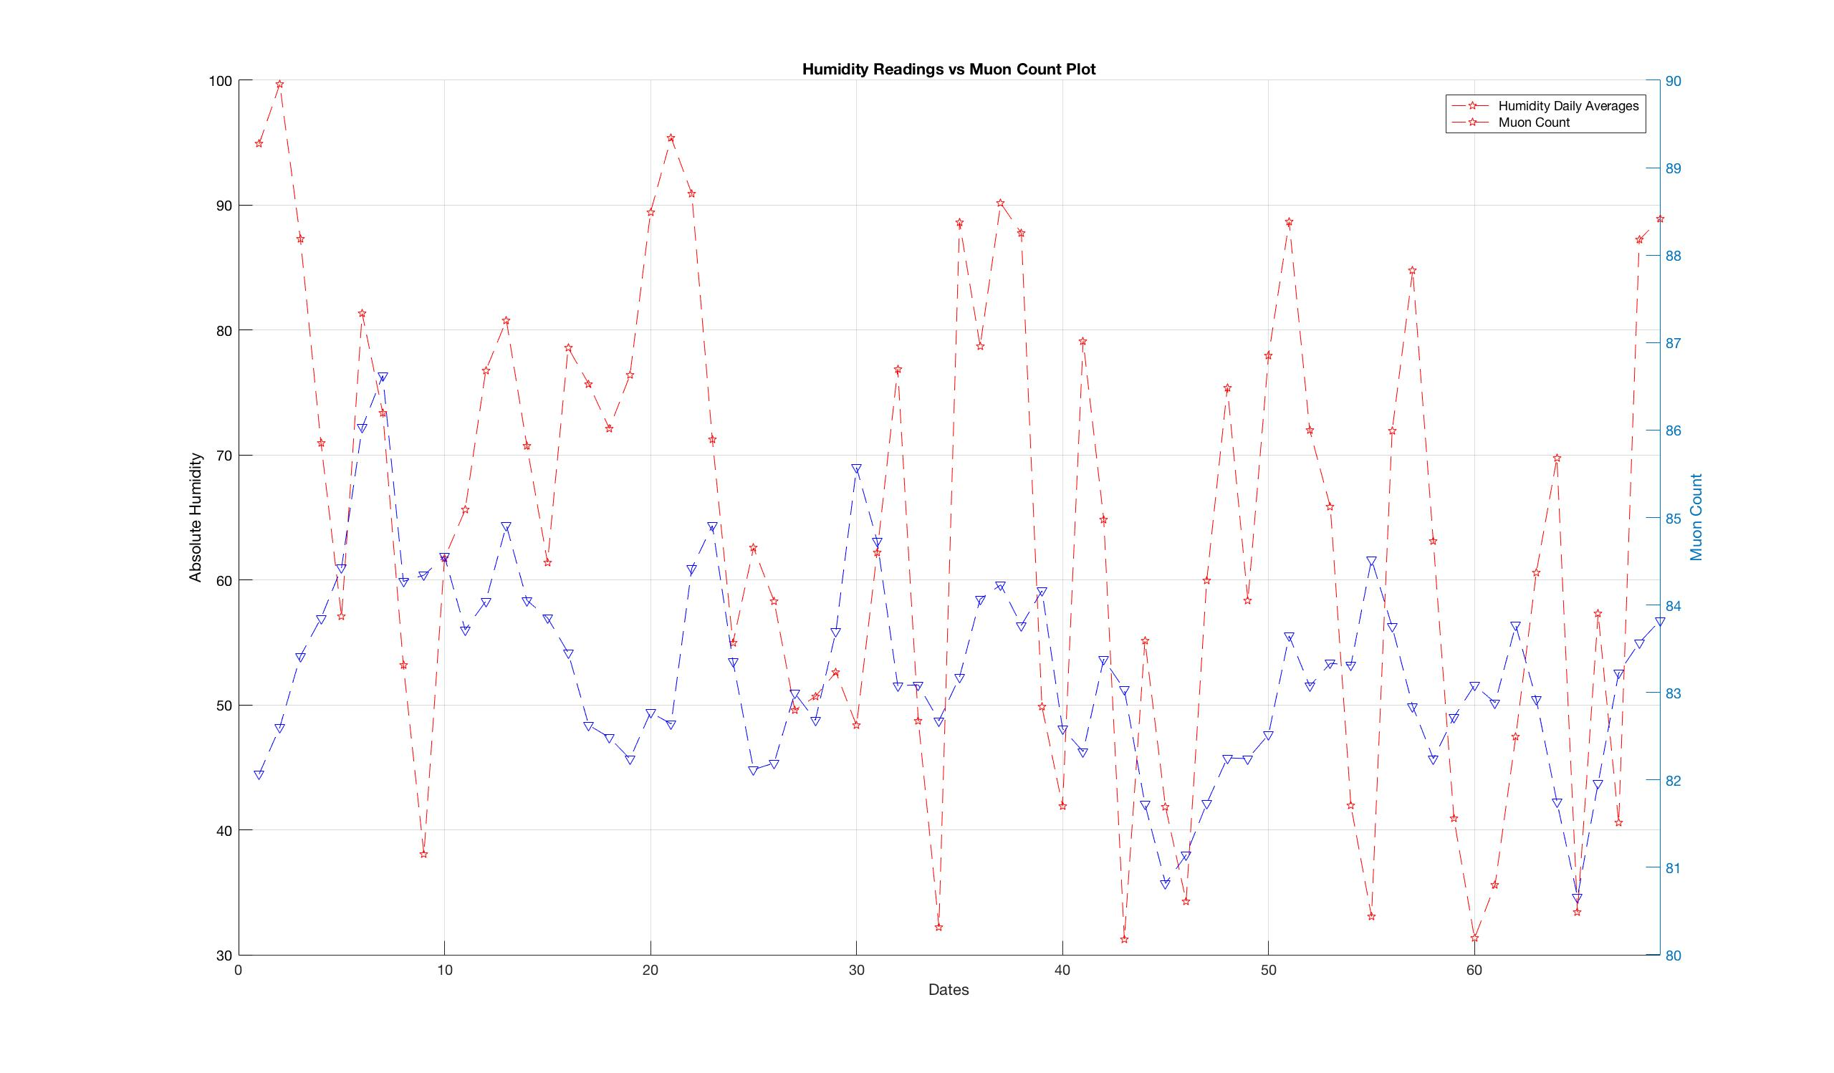
Muon Count vs Wind Humidity

Slide 19
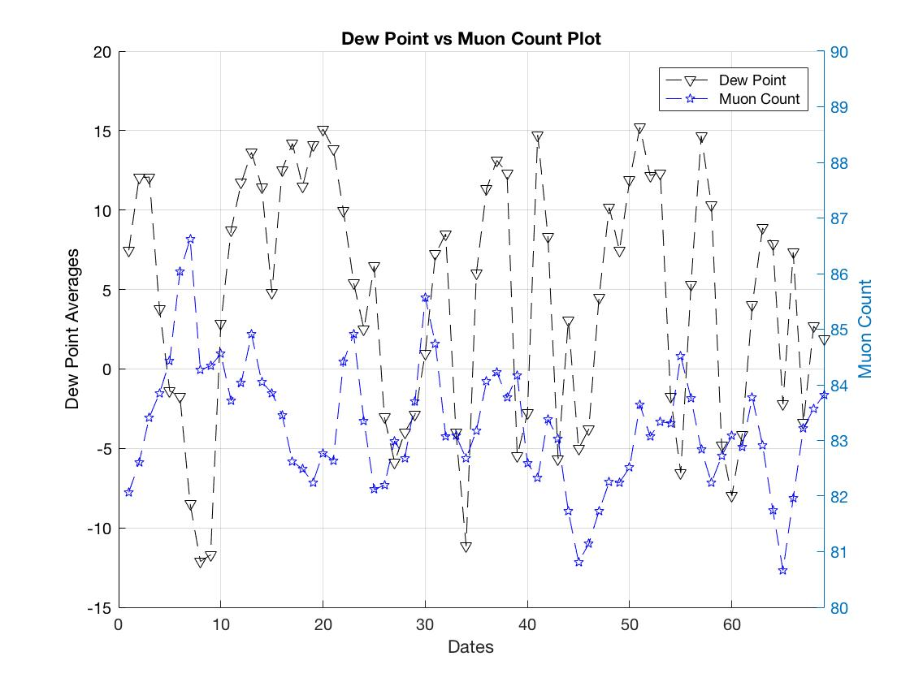
Muon Count vs Dew Point

Slide 20
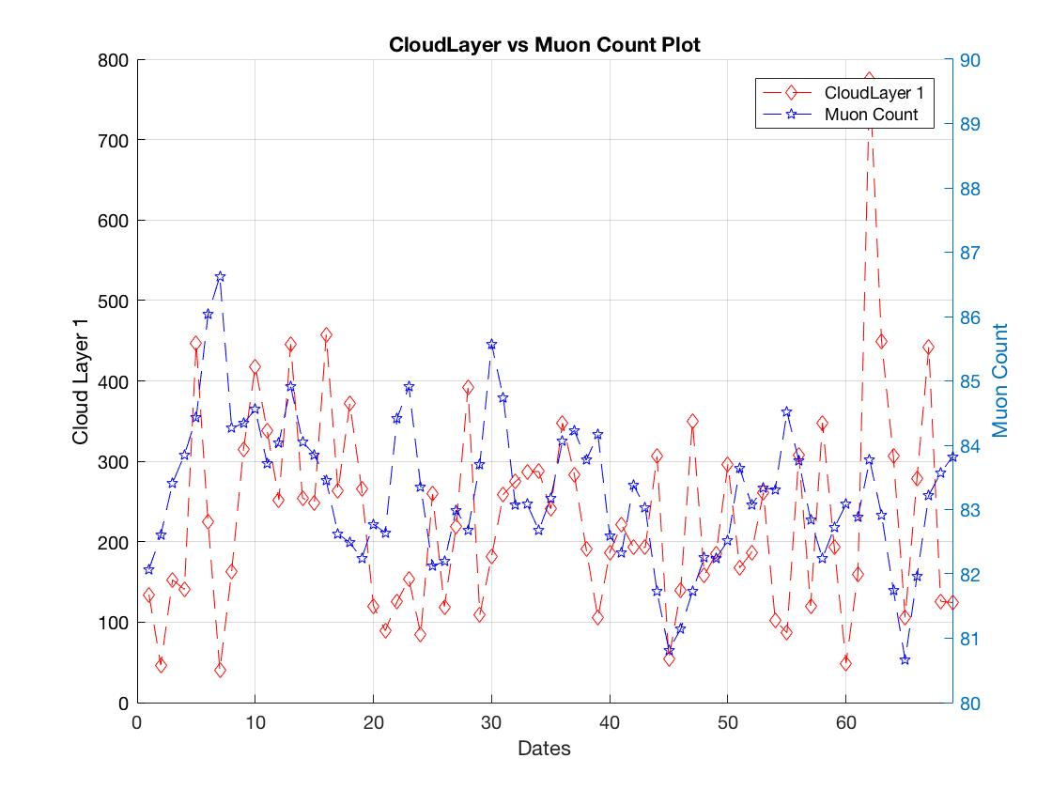
Muon Count vs Cloud Layer 1 Data

Slide 21
Linear Regression and Data Analysis
Matlab has built in functions which allow the user to generate defined tables which can be used for curve fitting and regression tools
After researching the various curve fitting ideas we found that linear regression is the best tool that can be used for prediction from our data.
How matlab function works is by using defined matrices of the same row length and developing linear regression for data set and using the other as a response variable
Example :
MuonCount_vs_TemperatureReadingLinearModel = fitlm(MuonCount_vs_TemperatureReadingTable, 'linear');
This command makes a linear regression model using a table of data points and muon count as the response variable

Slide 22
Linear Model and Table for Muon Count vs Temperature
file:///Users/luciusanderson/Documents/FinalMatlab%20Presentation/Tables/MuonCount.html

Slide 23
Acknowledgments
http://www.hep.vanderbilt.edu/~webstems/qnweb/qnpptr/What_is_a_Muon.pdf
http://www.quantumdiaries.org/wp-content/uploads/2010/04/muon.png
http://phynp6.phy-astr.gsu.edu/~cosmic/index.html
http://phynp6.phy-astr.gsu.edu/wordpress/index.php/research/cosmic-ray-science-at-gsu/
https://en.wikipedia.org/wiki/MesoWest

